Slide 1
WELCOME TO
Global Communicators TMC
2026 - 2027 1H

Slide 2
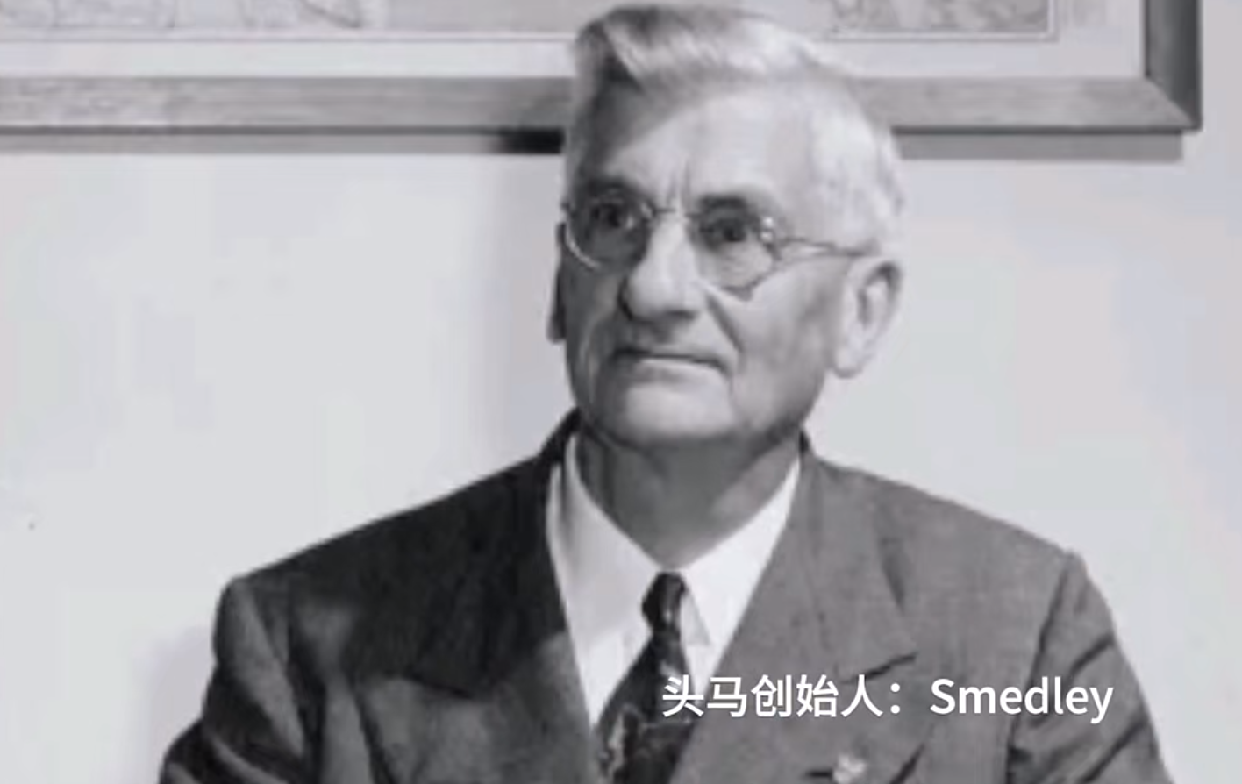
Founded in 1924 in California, USA‌
"A nonprofit educational organization"‌
Focused on developing public speaking, communication, and leadership skills‌
“There are no teachers here, only faster students. There is no pursuit of perfection, only progress.”

Slide 3
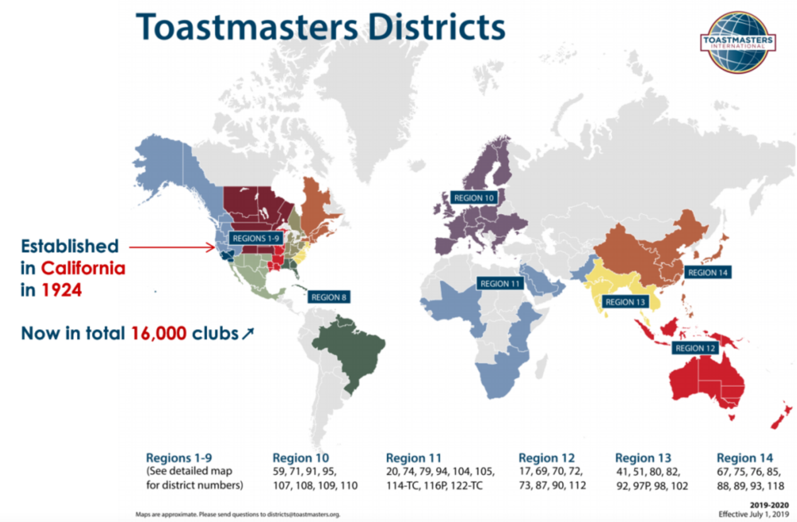
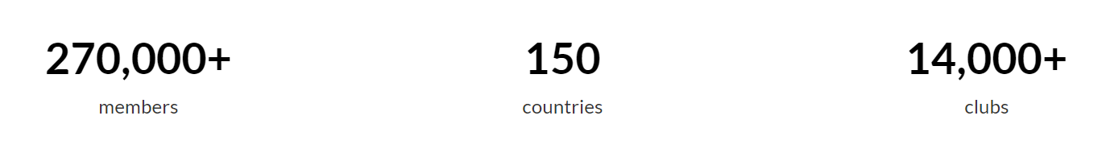
Toastmasters Worldwide

Slide 4
Why has Toastmasters been
102-year-old?

Slide 5
核心价值观 Toastmasters’ Values
诚信 Integrity
互相尊重 Respect
服务会员 Service
追求卓越 Excellence

Slide 6
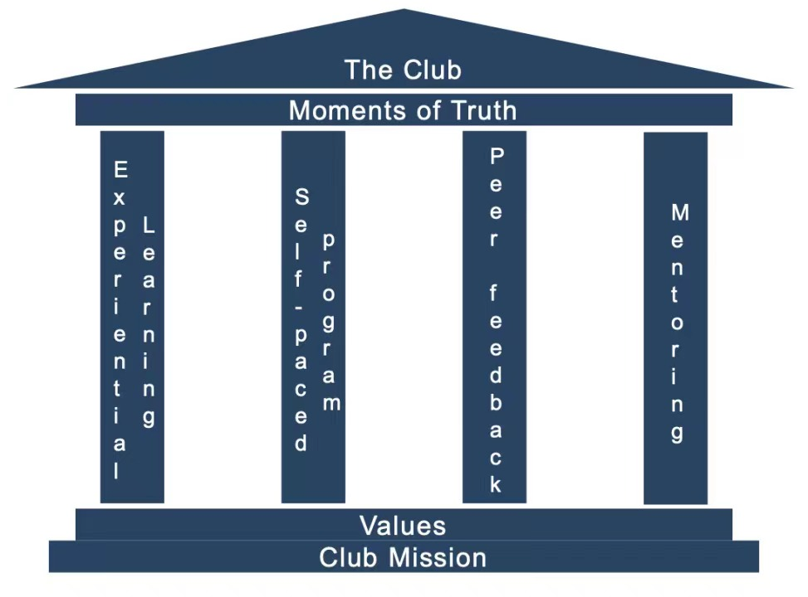
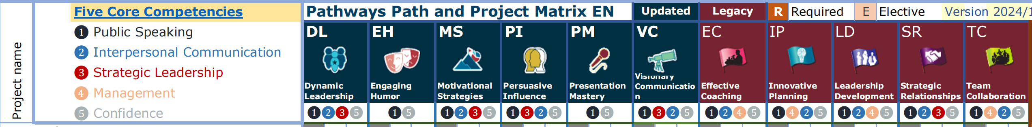
Education Resources

Slide 7
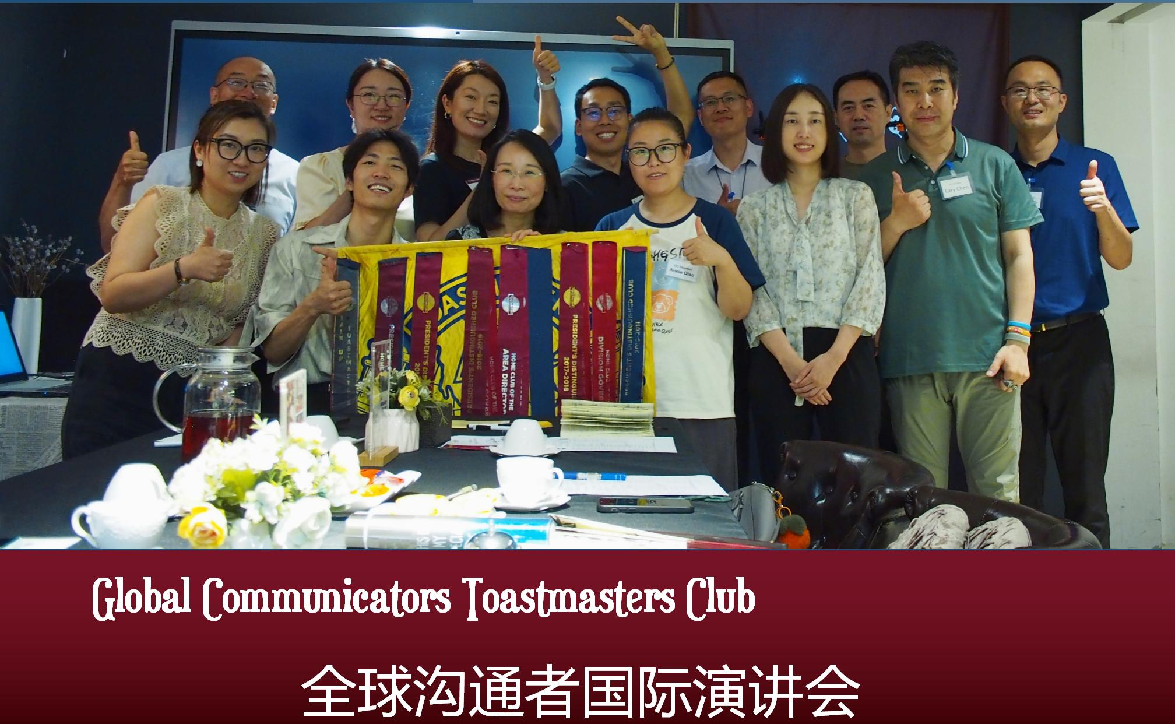
Global Communicators TMC
Founded on 1 December 2003
（北京最老牌）
An high-quality English-speaking club （会议质量高）
A cozy home for improvement
Club’s 3 ethos(调性) are
  • 心灵成长：soul-growth - achievement
  • 松弛感：laid-backness - environment
  • 人生阅历：experiences - basement

Slide 8
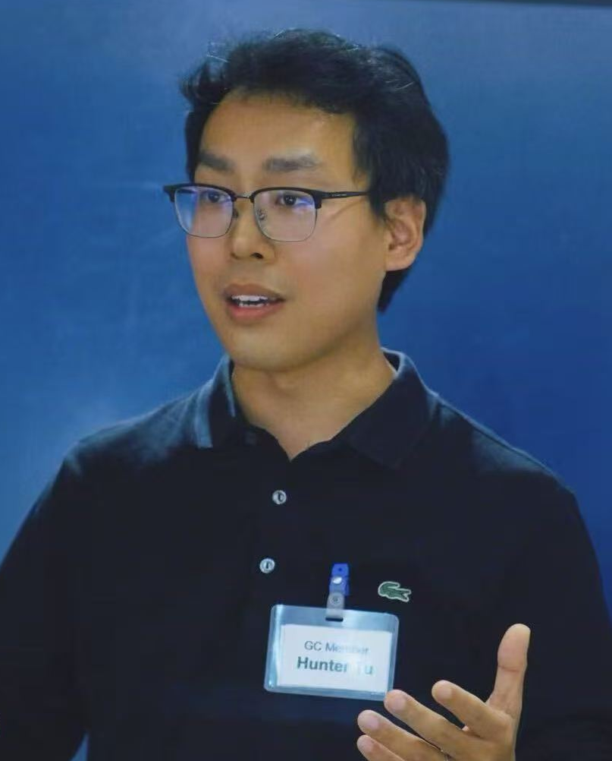
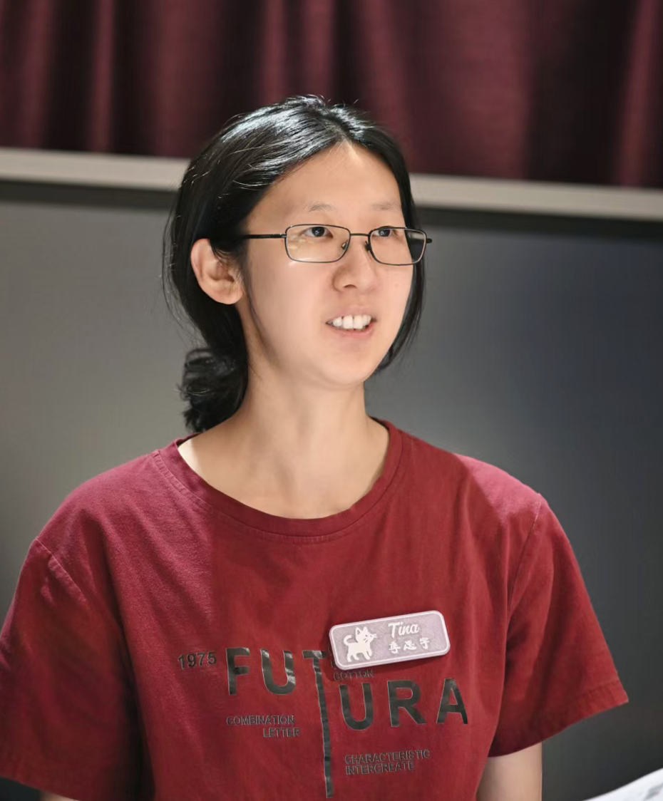
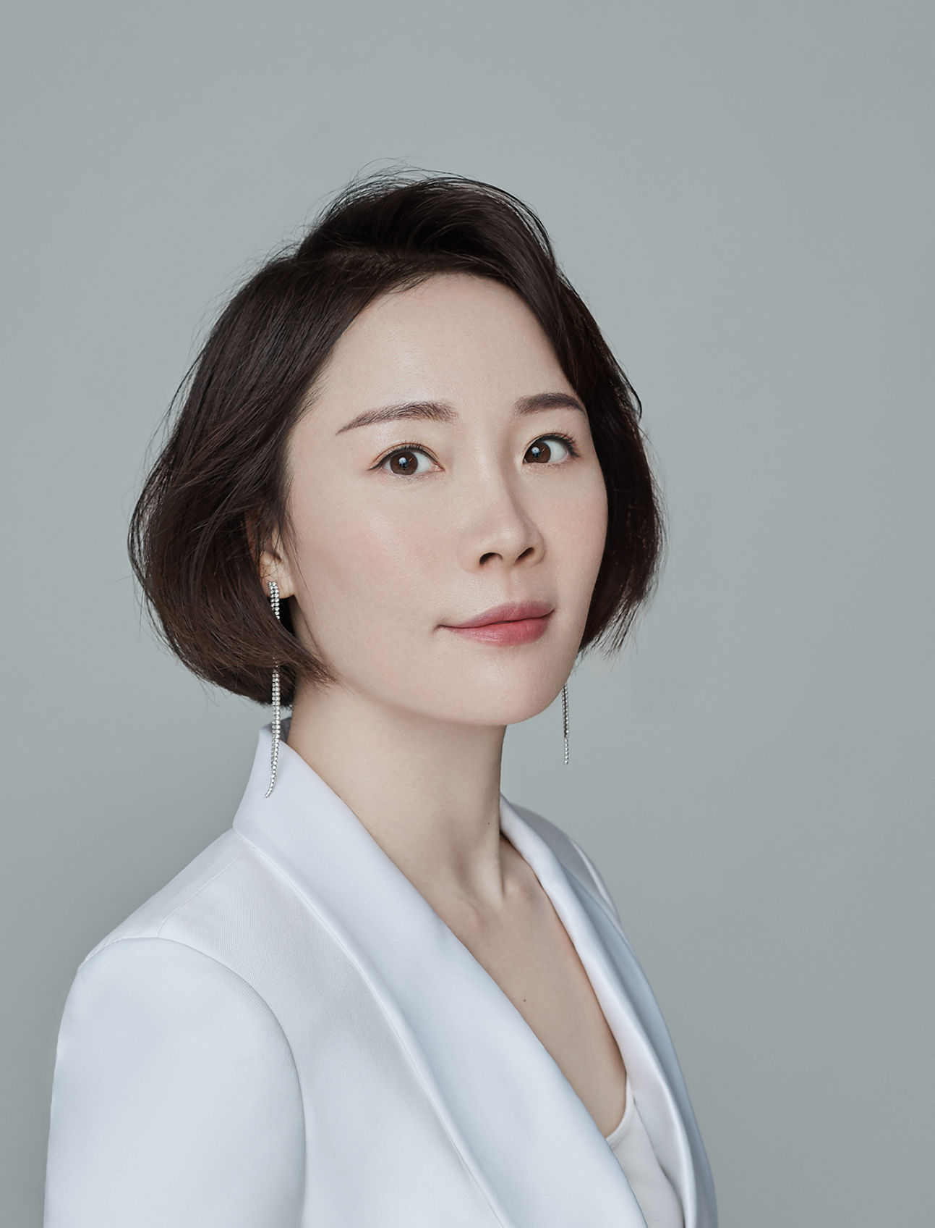
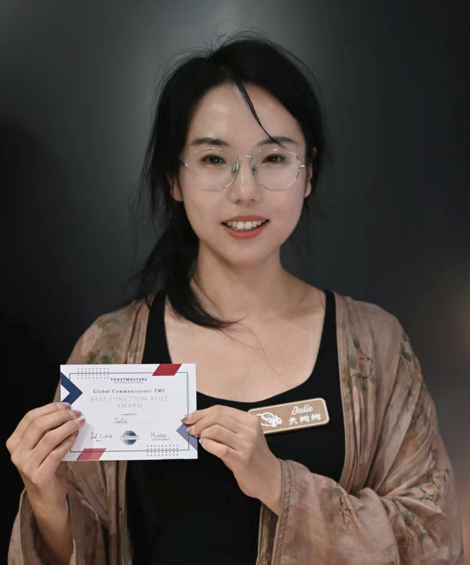
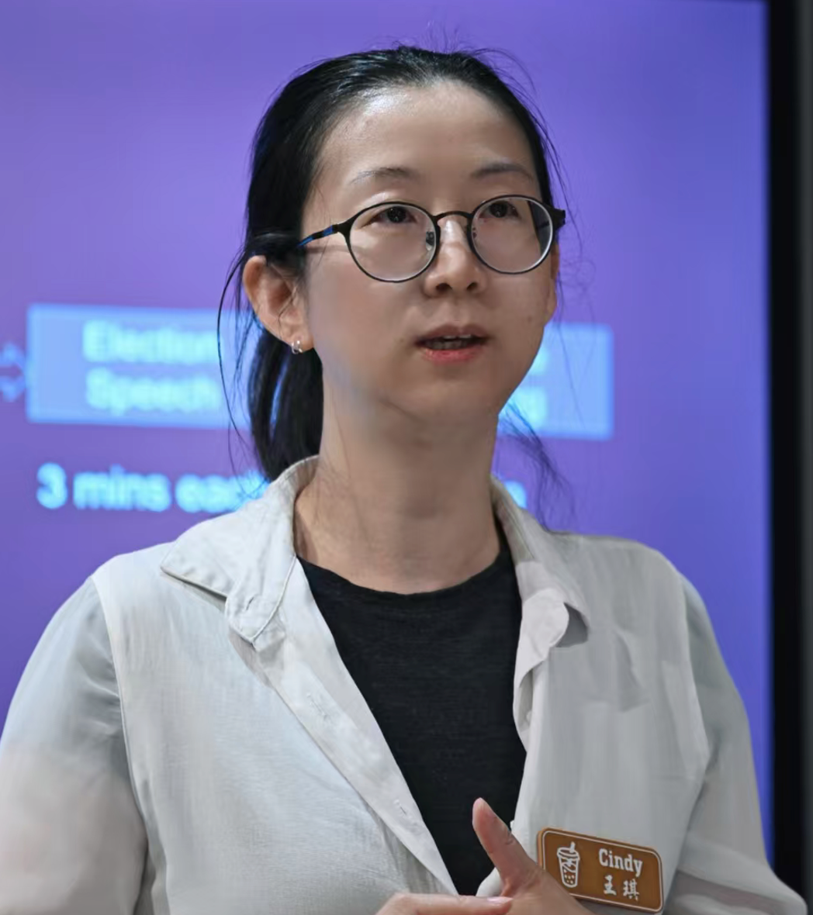
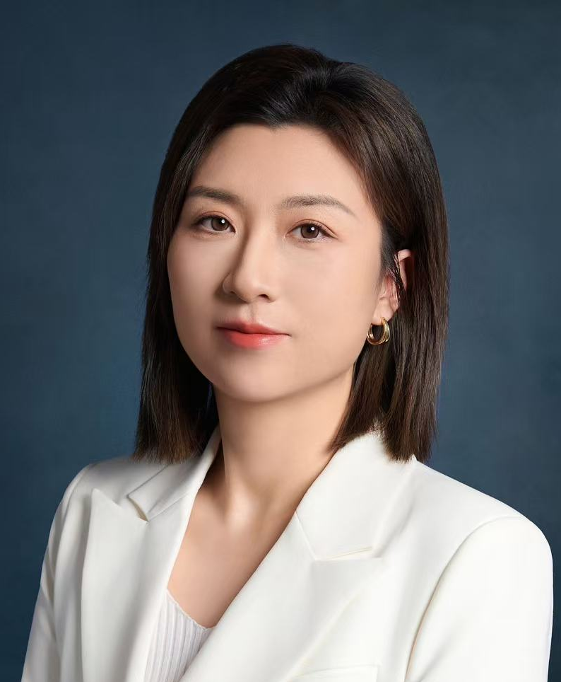
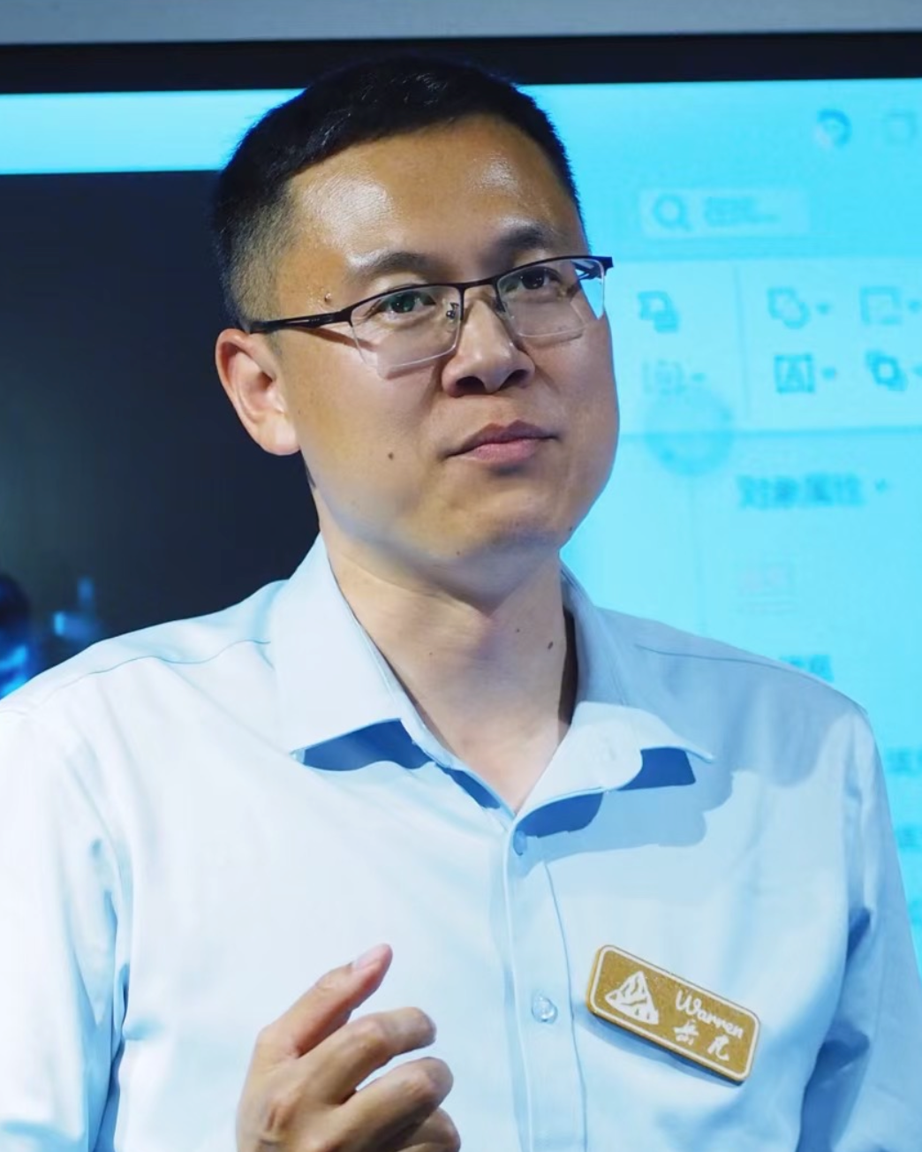
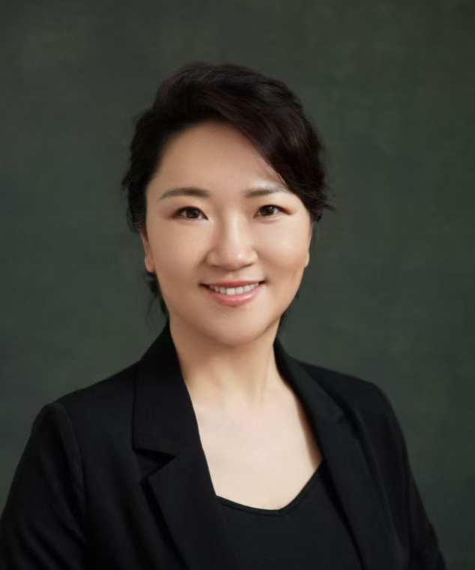
🛸GC万有引力 | UFO
United — 官员团队团结一致
Flight — 带领俱乐部腾飞、上升
Officers — 明确是官员/干事团队
•
寓意： 一群并肩作战的飞行官，驾驶俱乐部这艘飞船穿越星空。
President – Hunter TU
VPE – Tina JI
VPM – Yunduan FAN
VPPR – Julie GUAN
Treasurer - Cindy WANG
SAA – Lei WANG
Secretary – Warren YUE
IPP – Sarah FENG

Slide 9
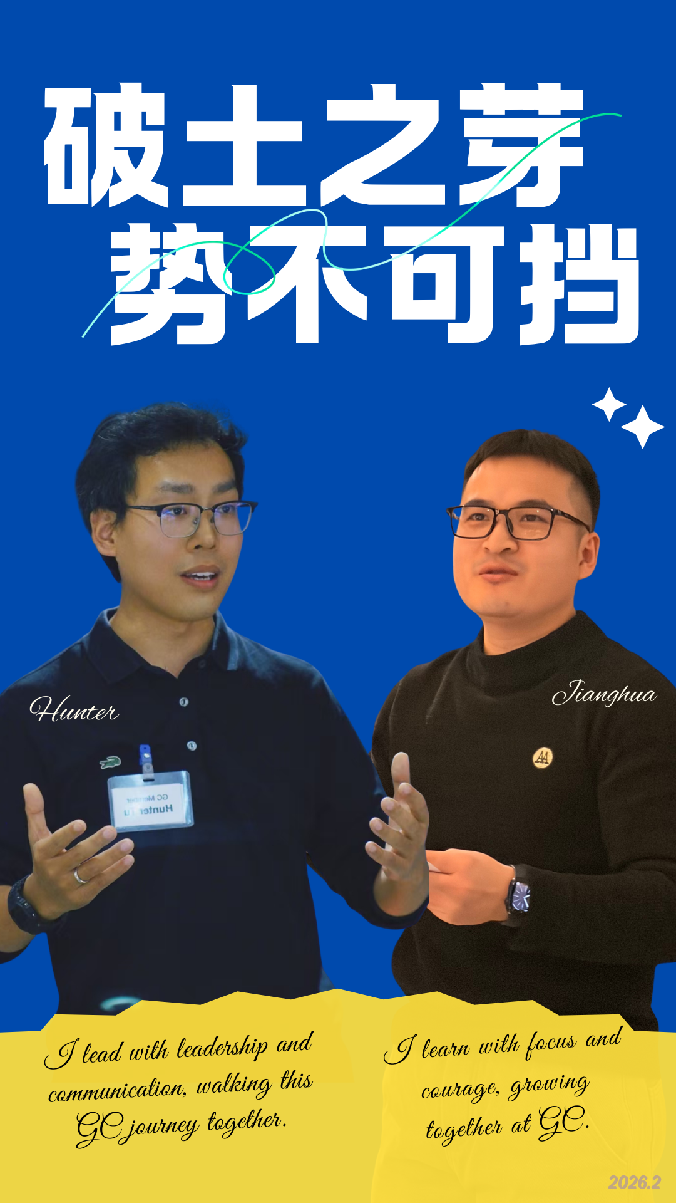
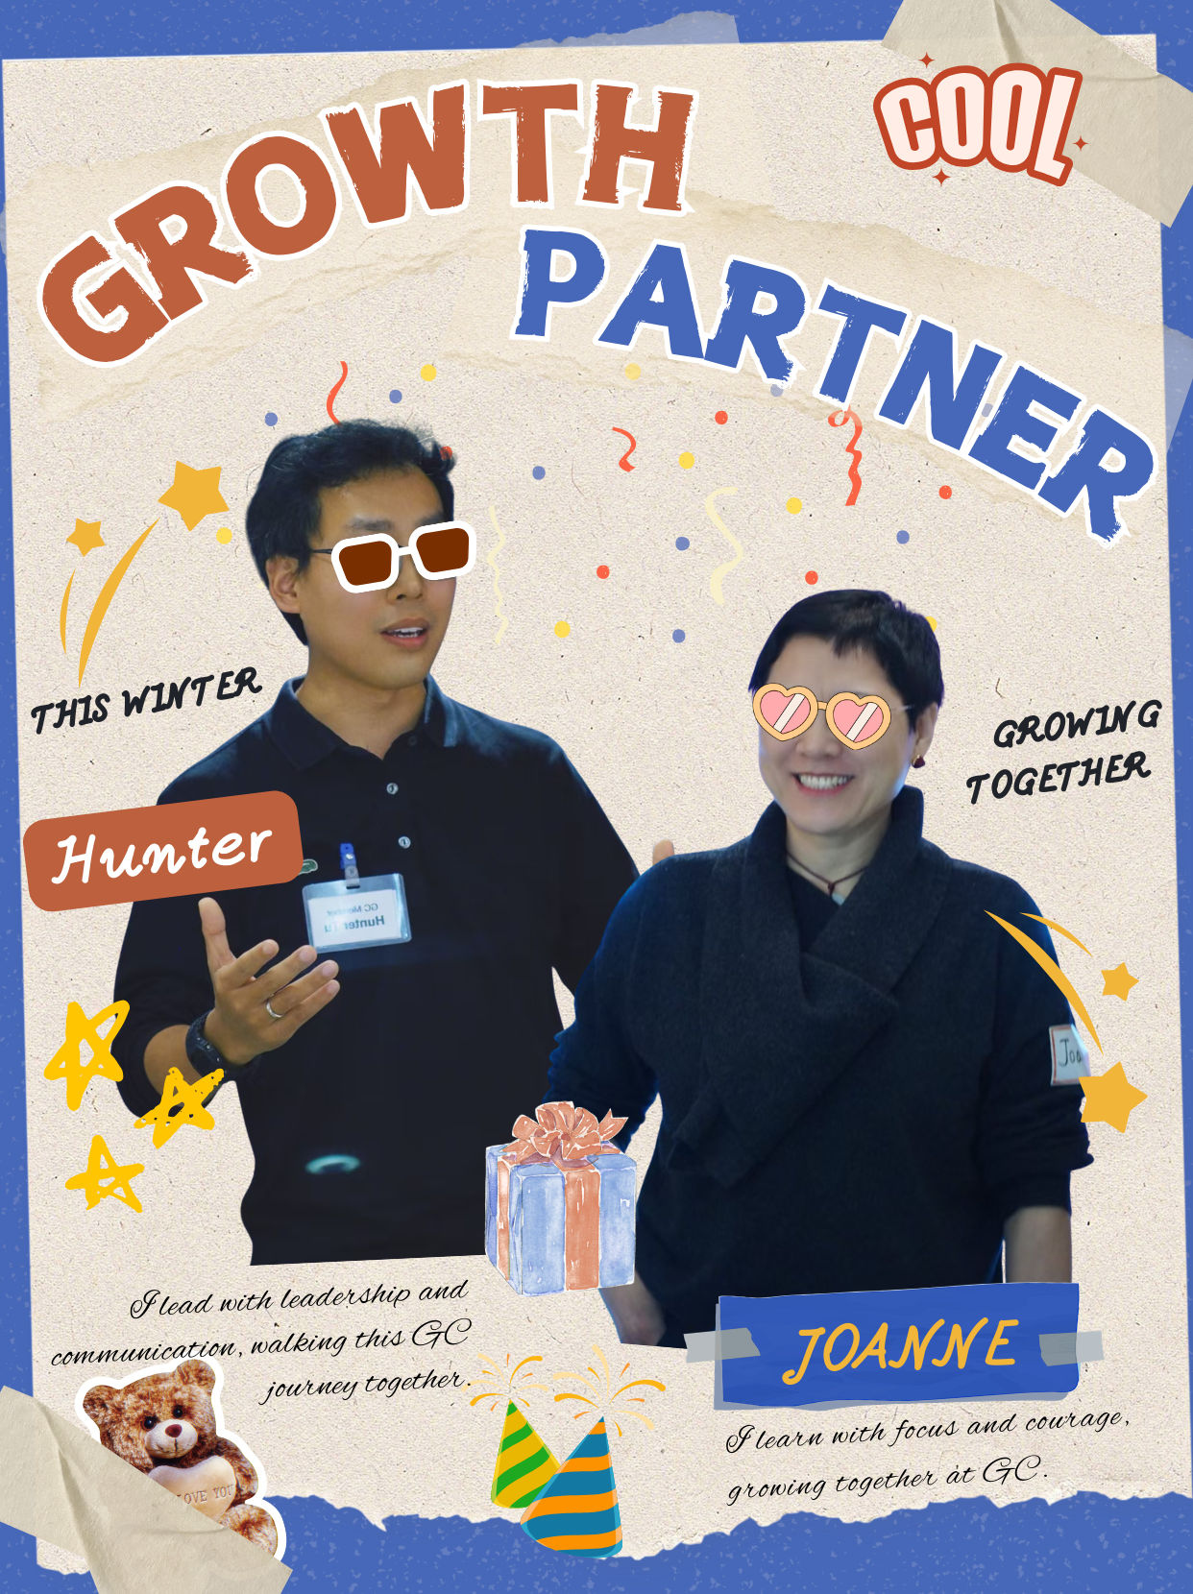
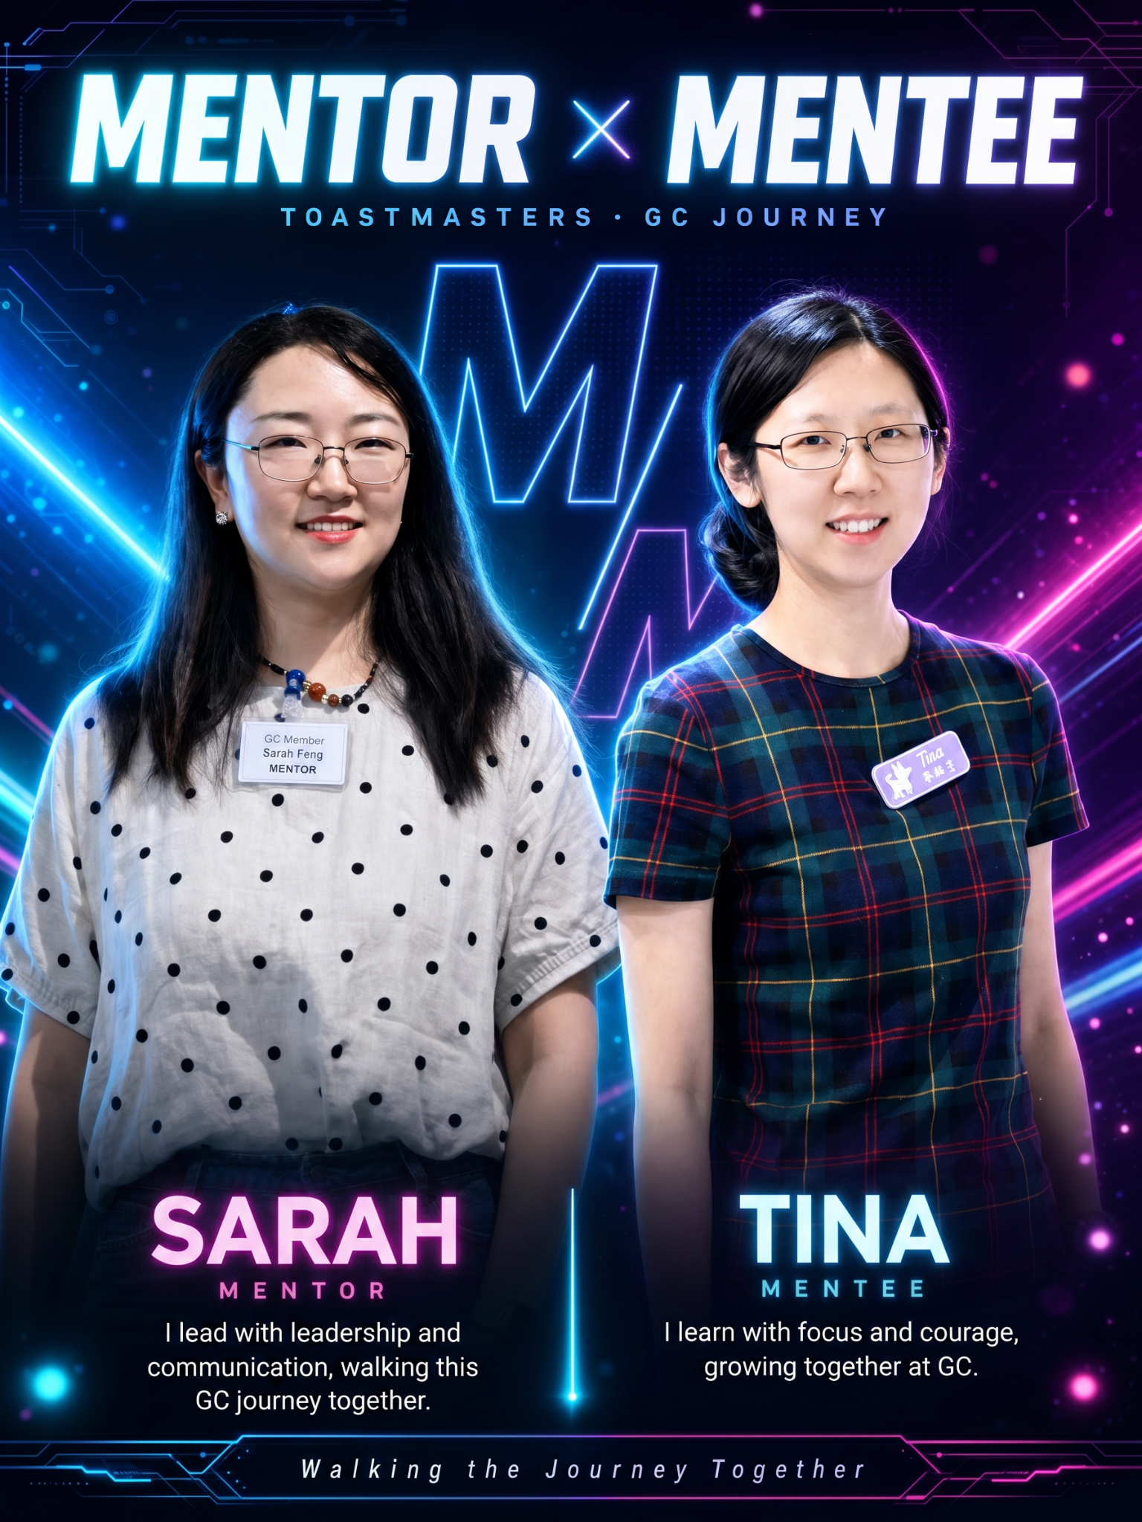
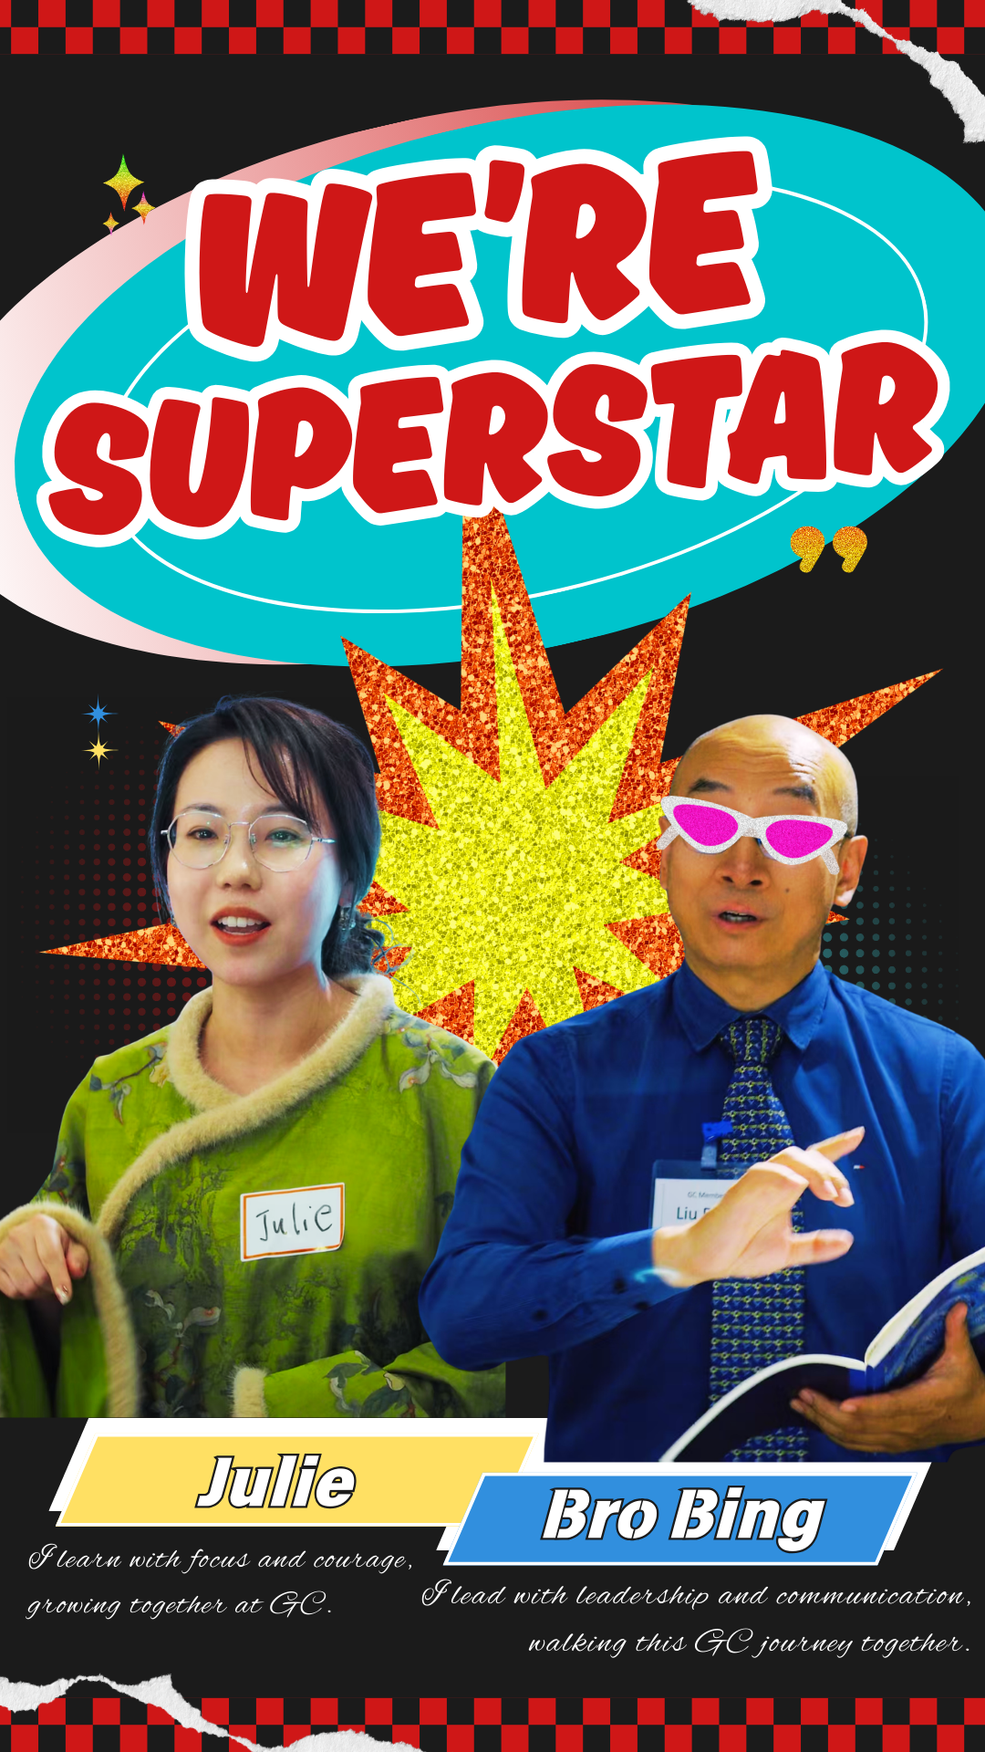
Mentoring System
GC Mentors:
Bing
Cary
Yunduan
Sarah
Ano
Hunter
Bella
Philbert
Maggie

Slide 10

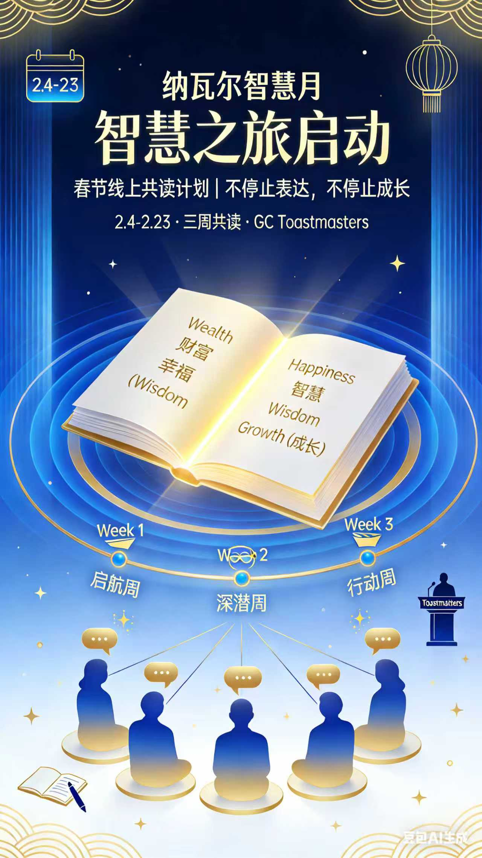

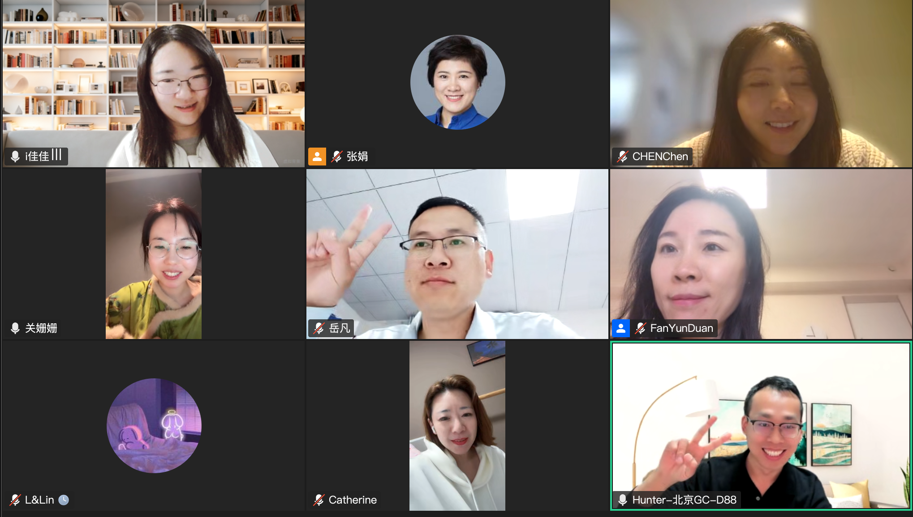
GC Book Club

Slide 11
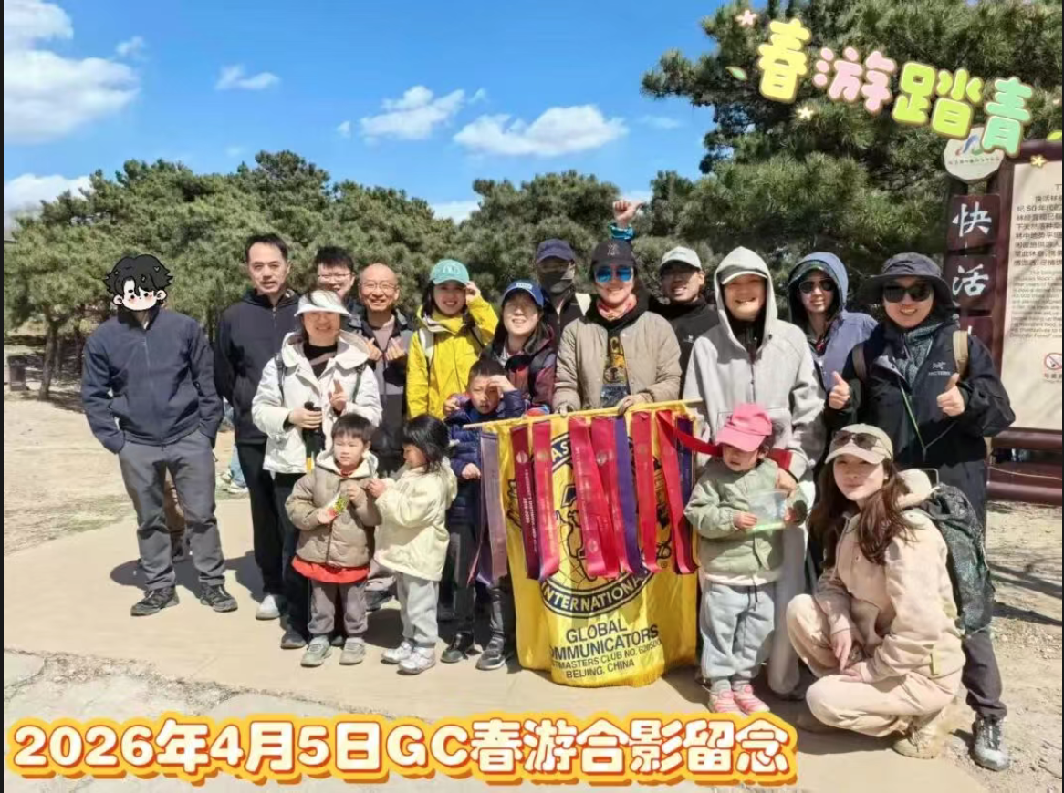
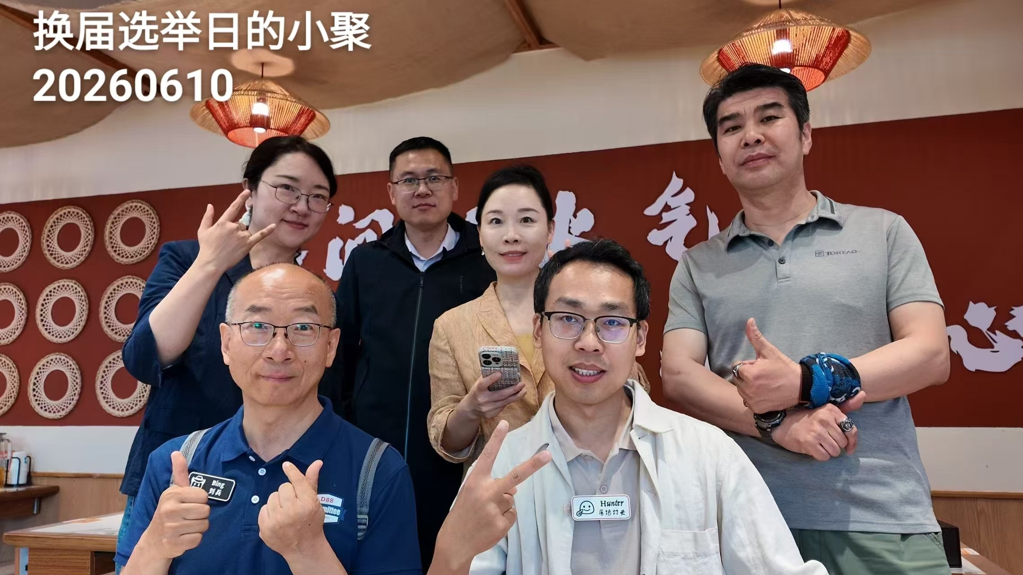
GC Activity

Slide 12
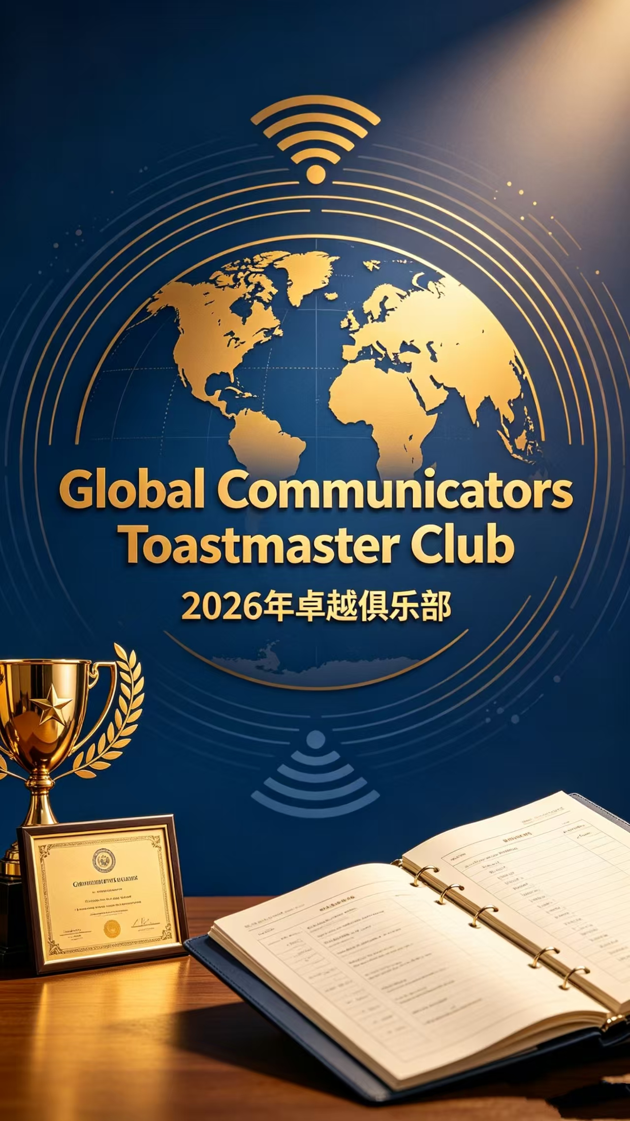
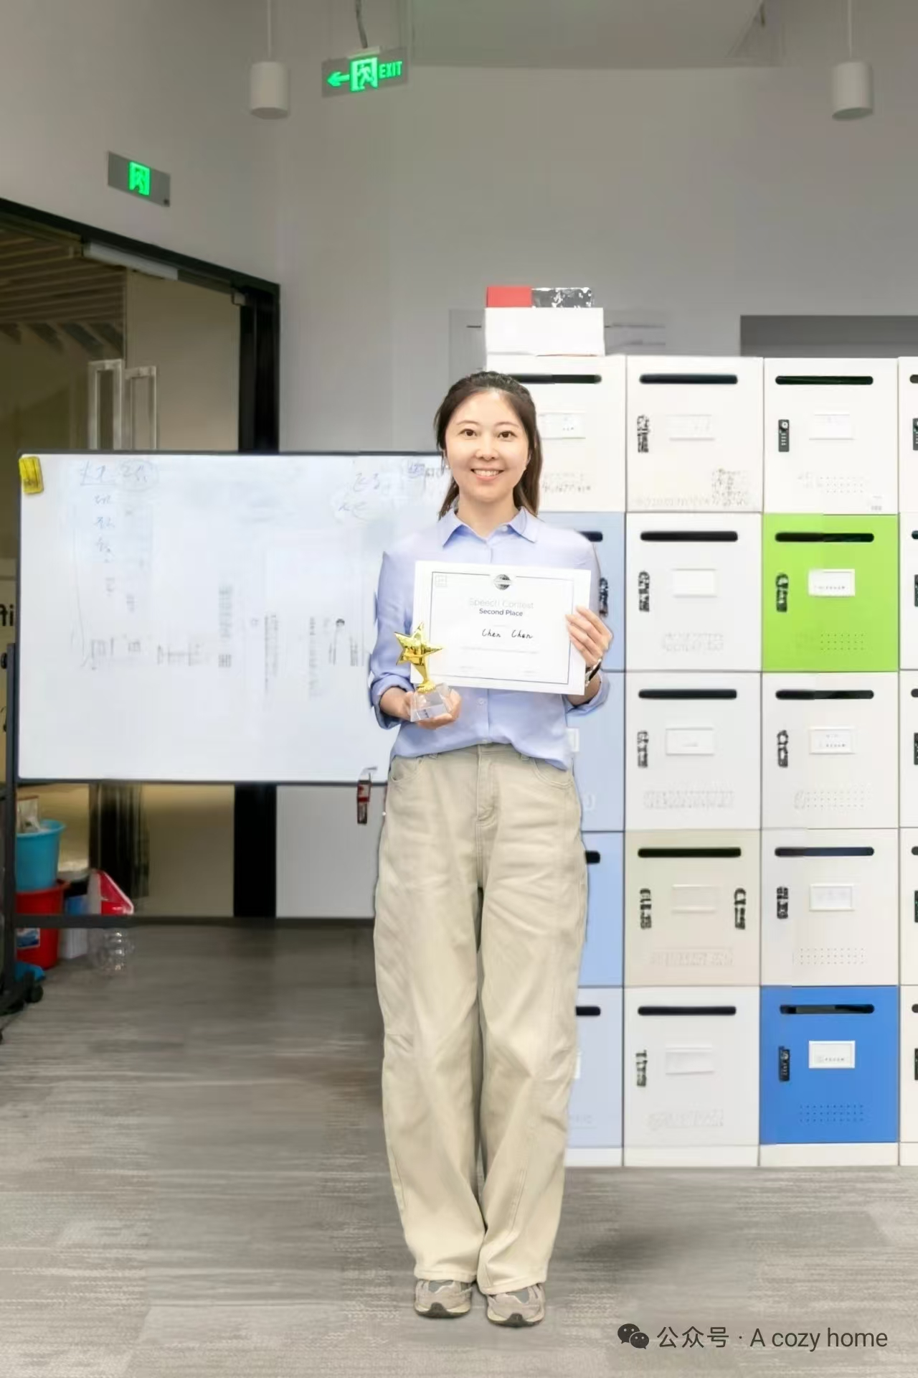
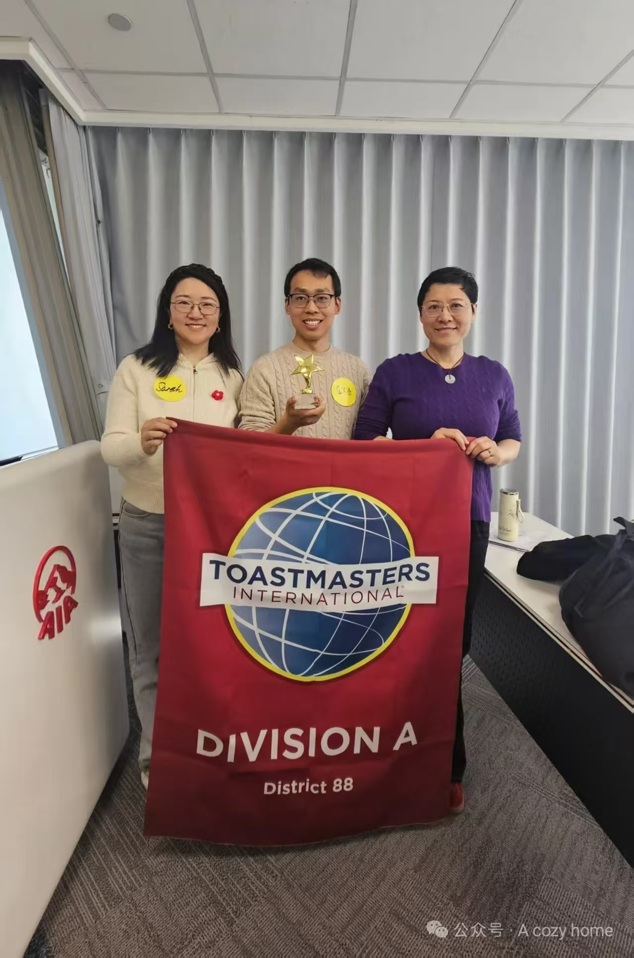
GC Award in 2026
🏆 Bella( Chen Chen）——中区英文演讲比赛 第二名
🏆 Hunter —— 中区中文演讲比赛 第三名
卓越俱乐部奖

Slide 13
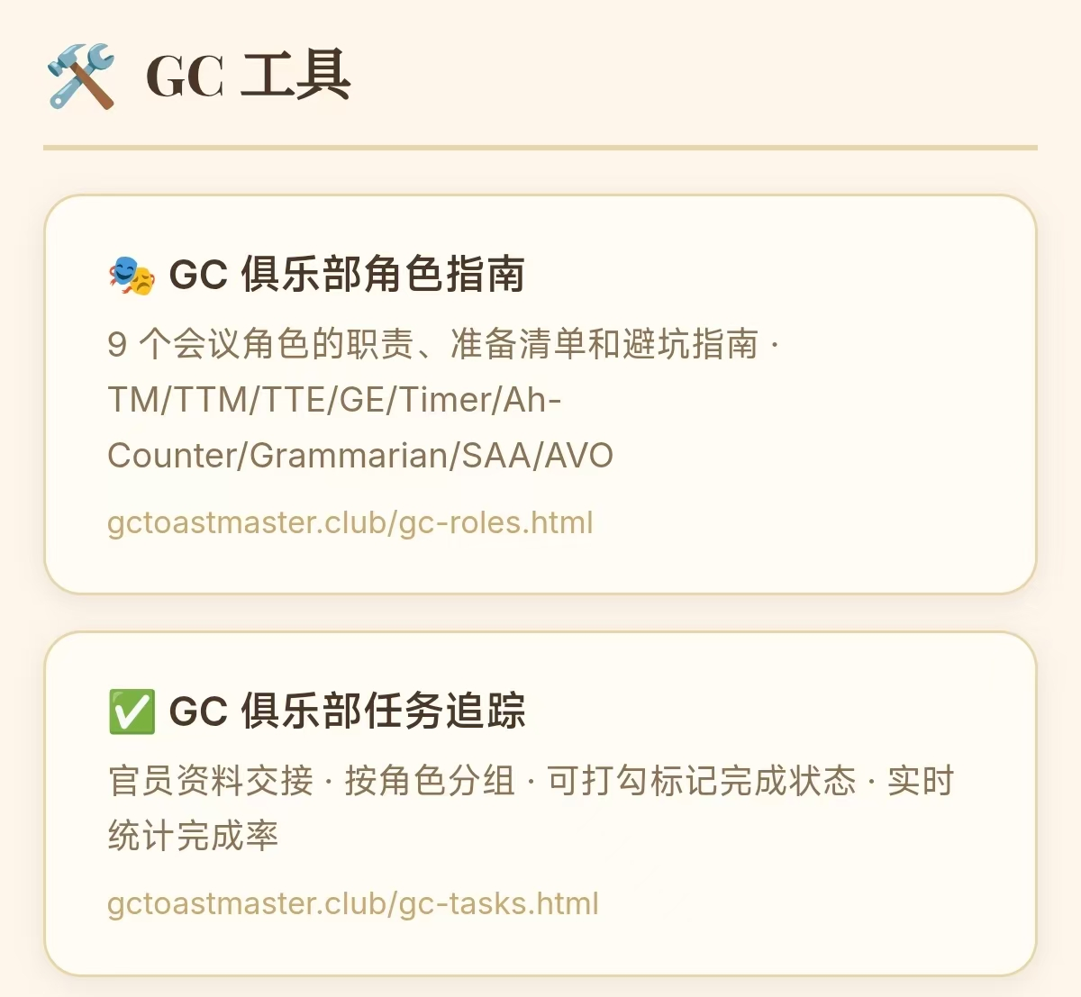
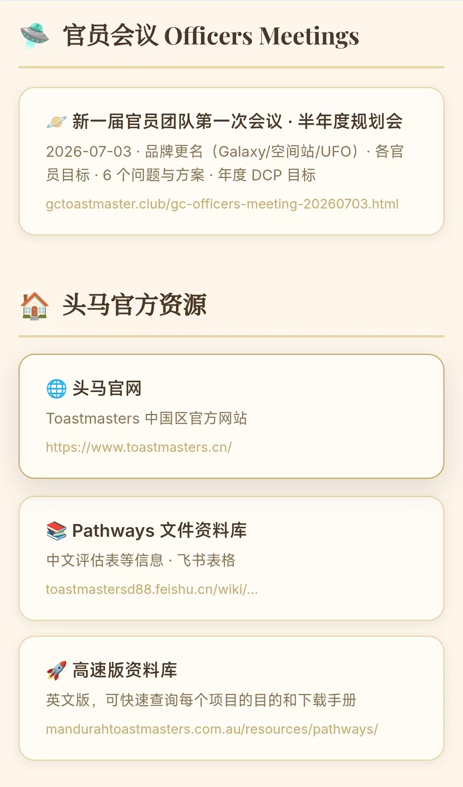
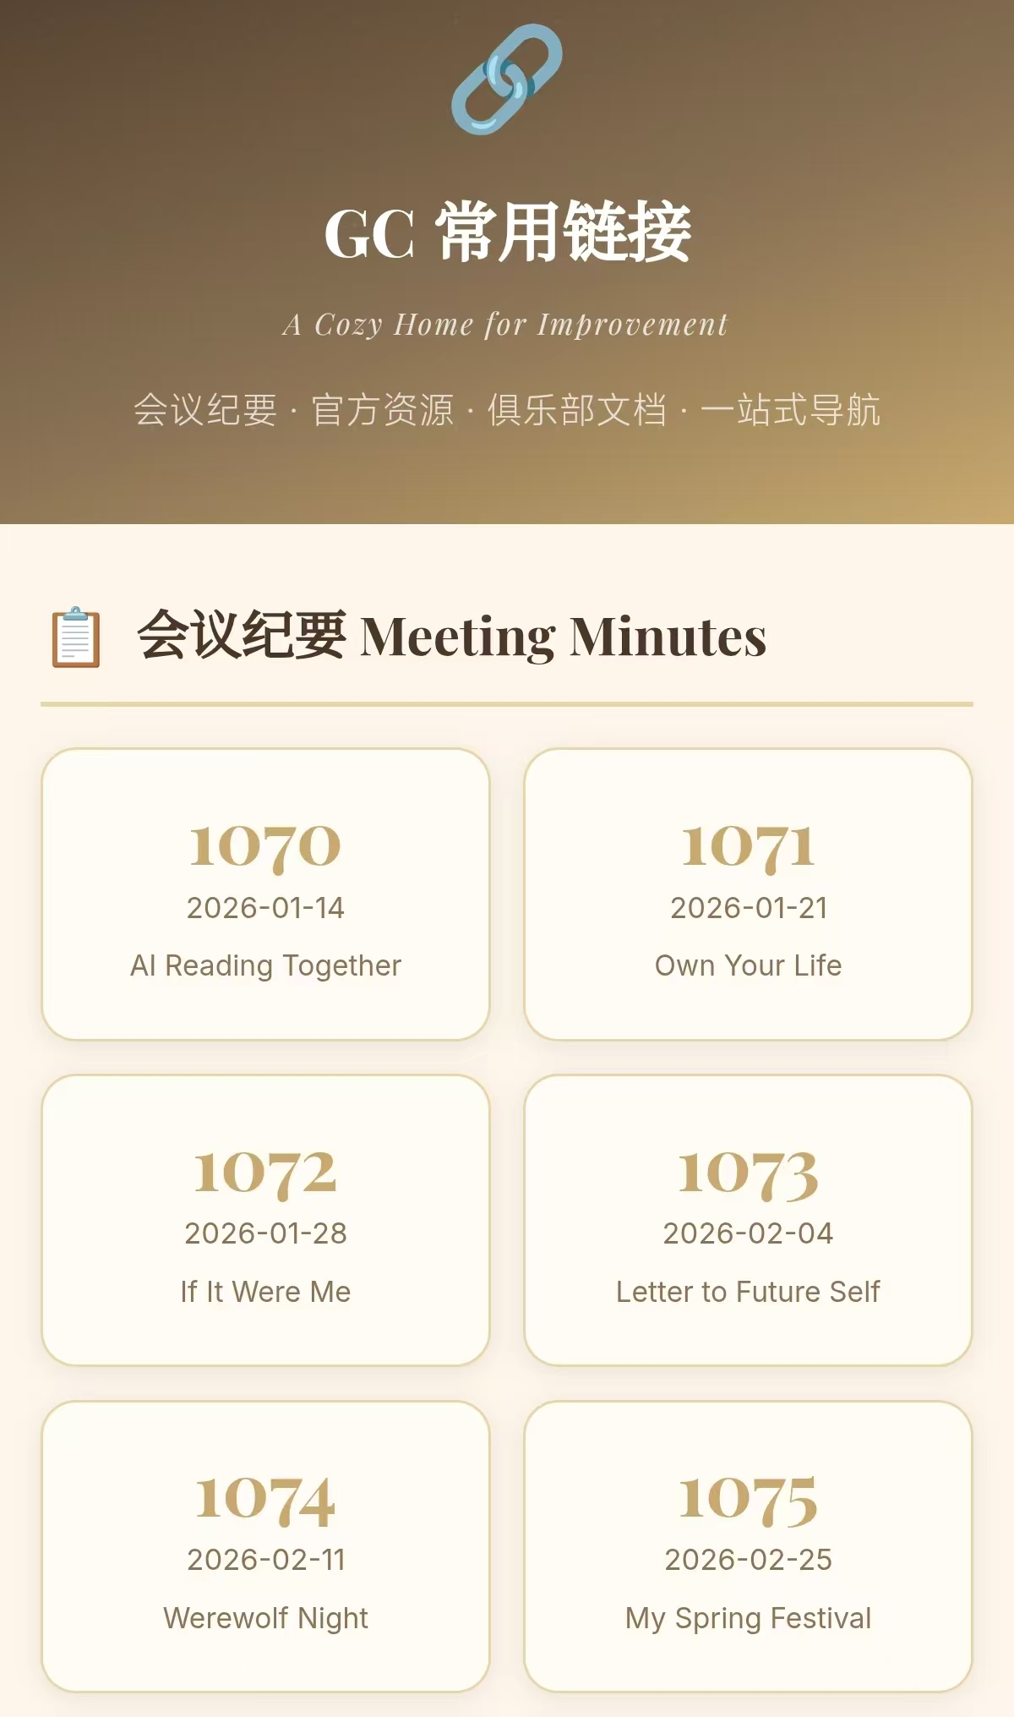
GC Brain – Exclusive Memory Vault（GC大脑 – 专属记忆库）

Slide 14
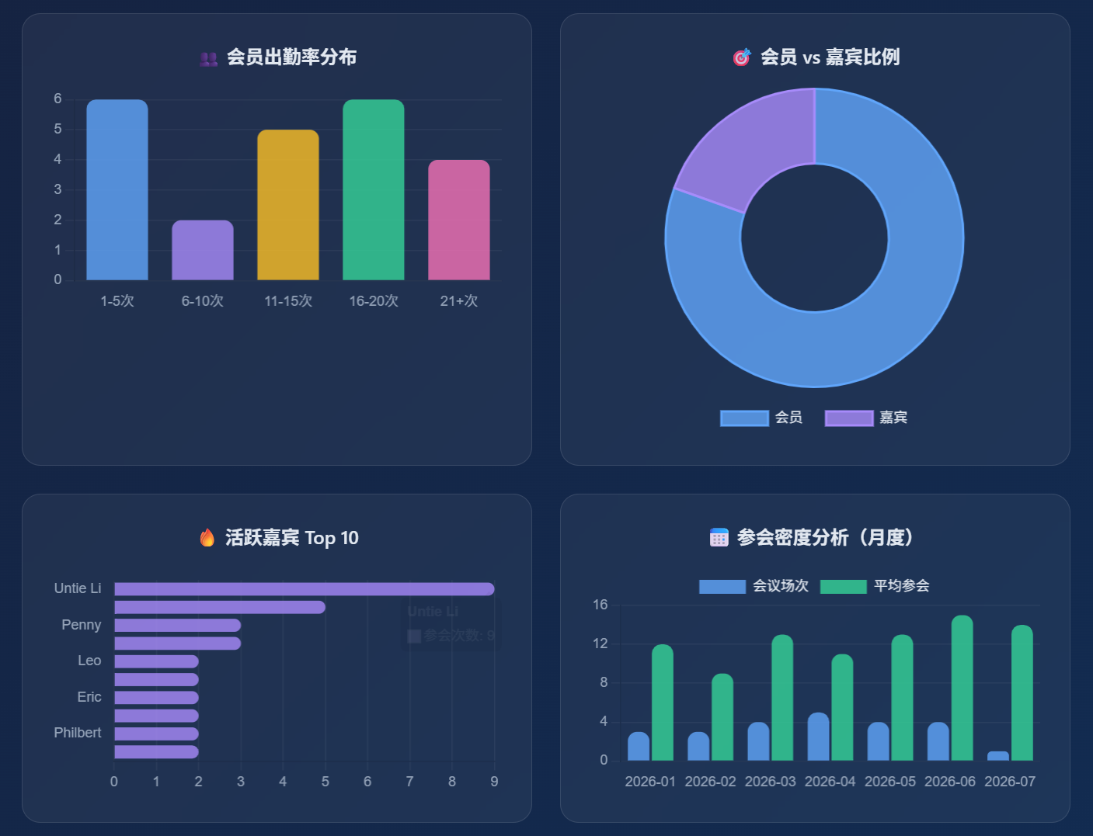
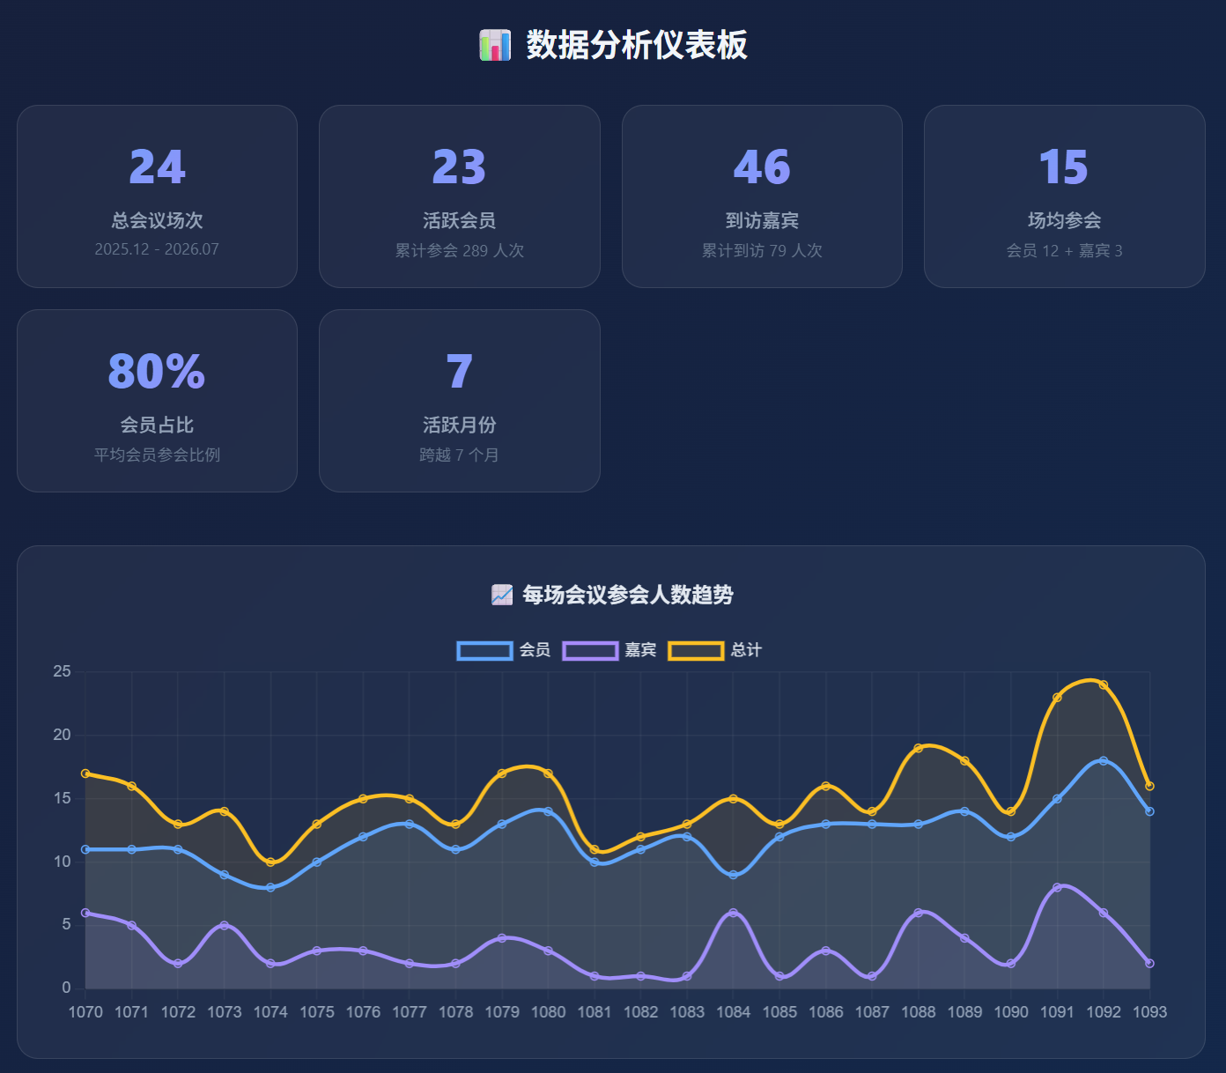
GC OpenClaw Dashboard（GC龙虾-俱乐部数据看板）

Slide 15
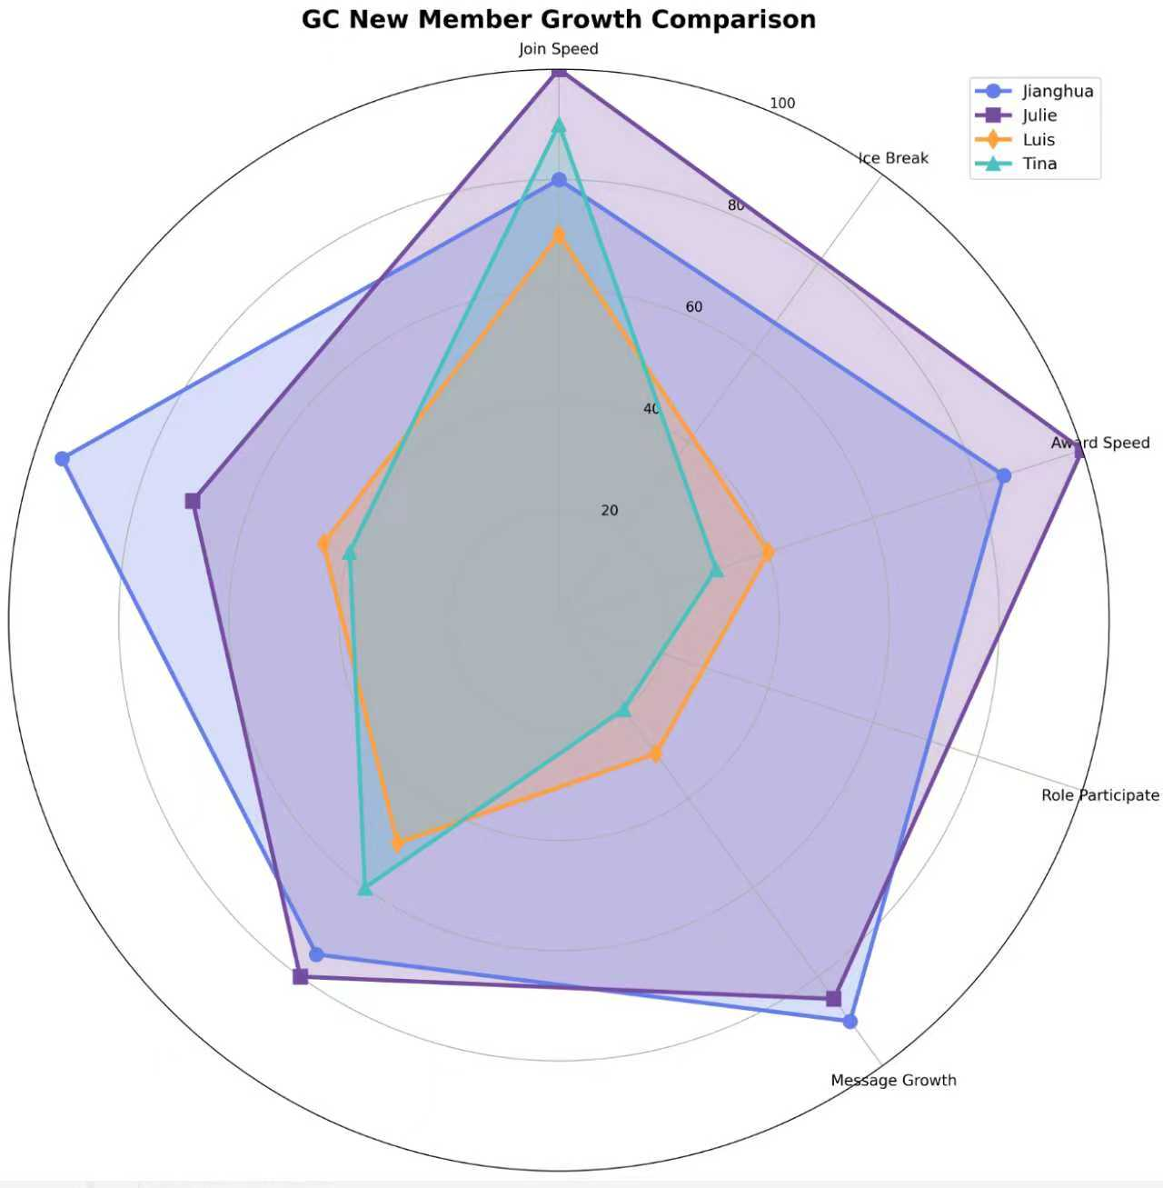
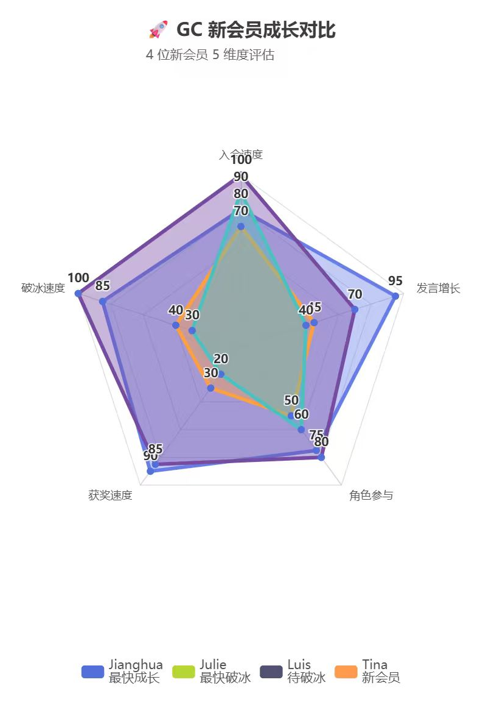
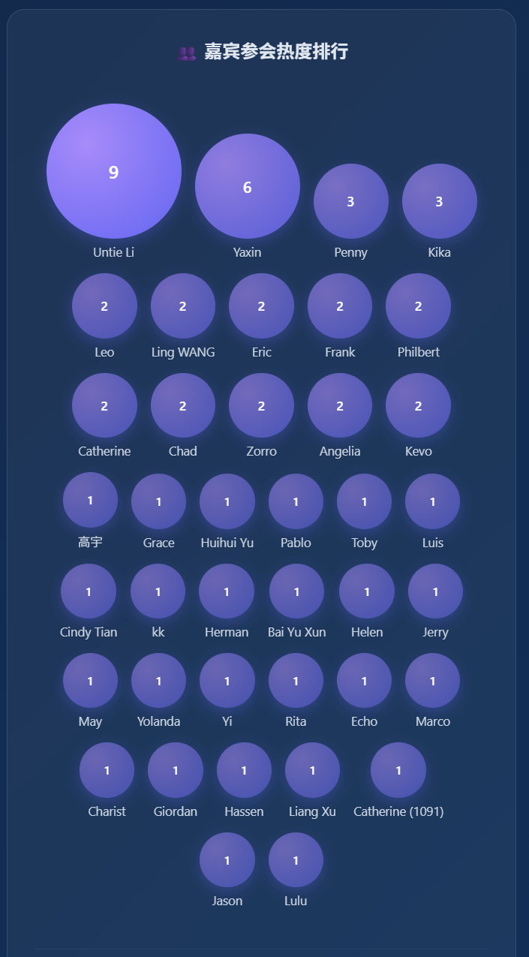
AI-Powered Growth for GC Members（用AI赋能GC会员成长）

Slide 16



Four Taboos during meeting
Politics
Religion
Race
Sex
Etiquette during meeting

Slide 17

Guest Introduction
Reference：
Your name？
How do you know GC?
Your expectations for this meeting？
30 seconds per person

